Slide 1
Estimated Cell Line Ancestry
Sydney Greeno
Supervised by Steven Eschrich and Anders Berglund

Slide 2
Use machine learning algorithm
PCA? UMAP? T-SNE?

Slide 3
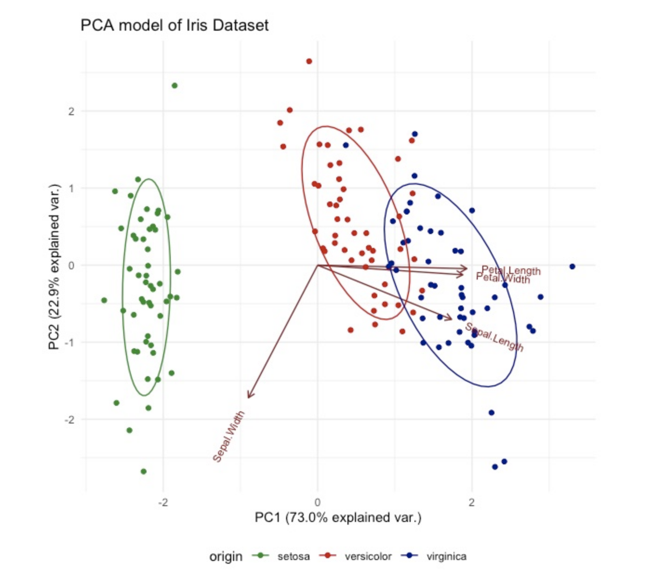
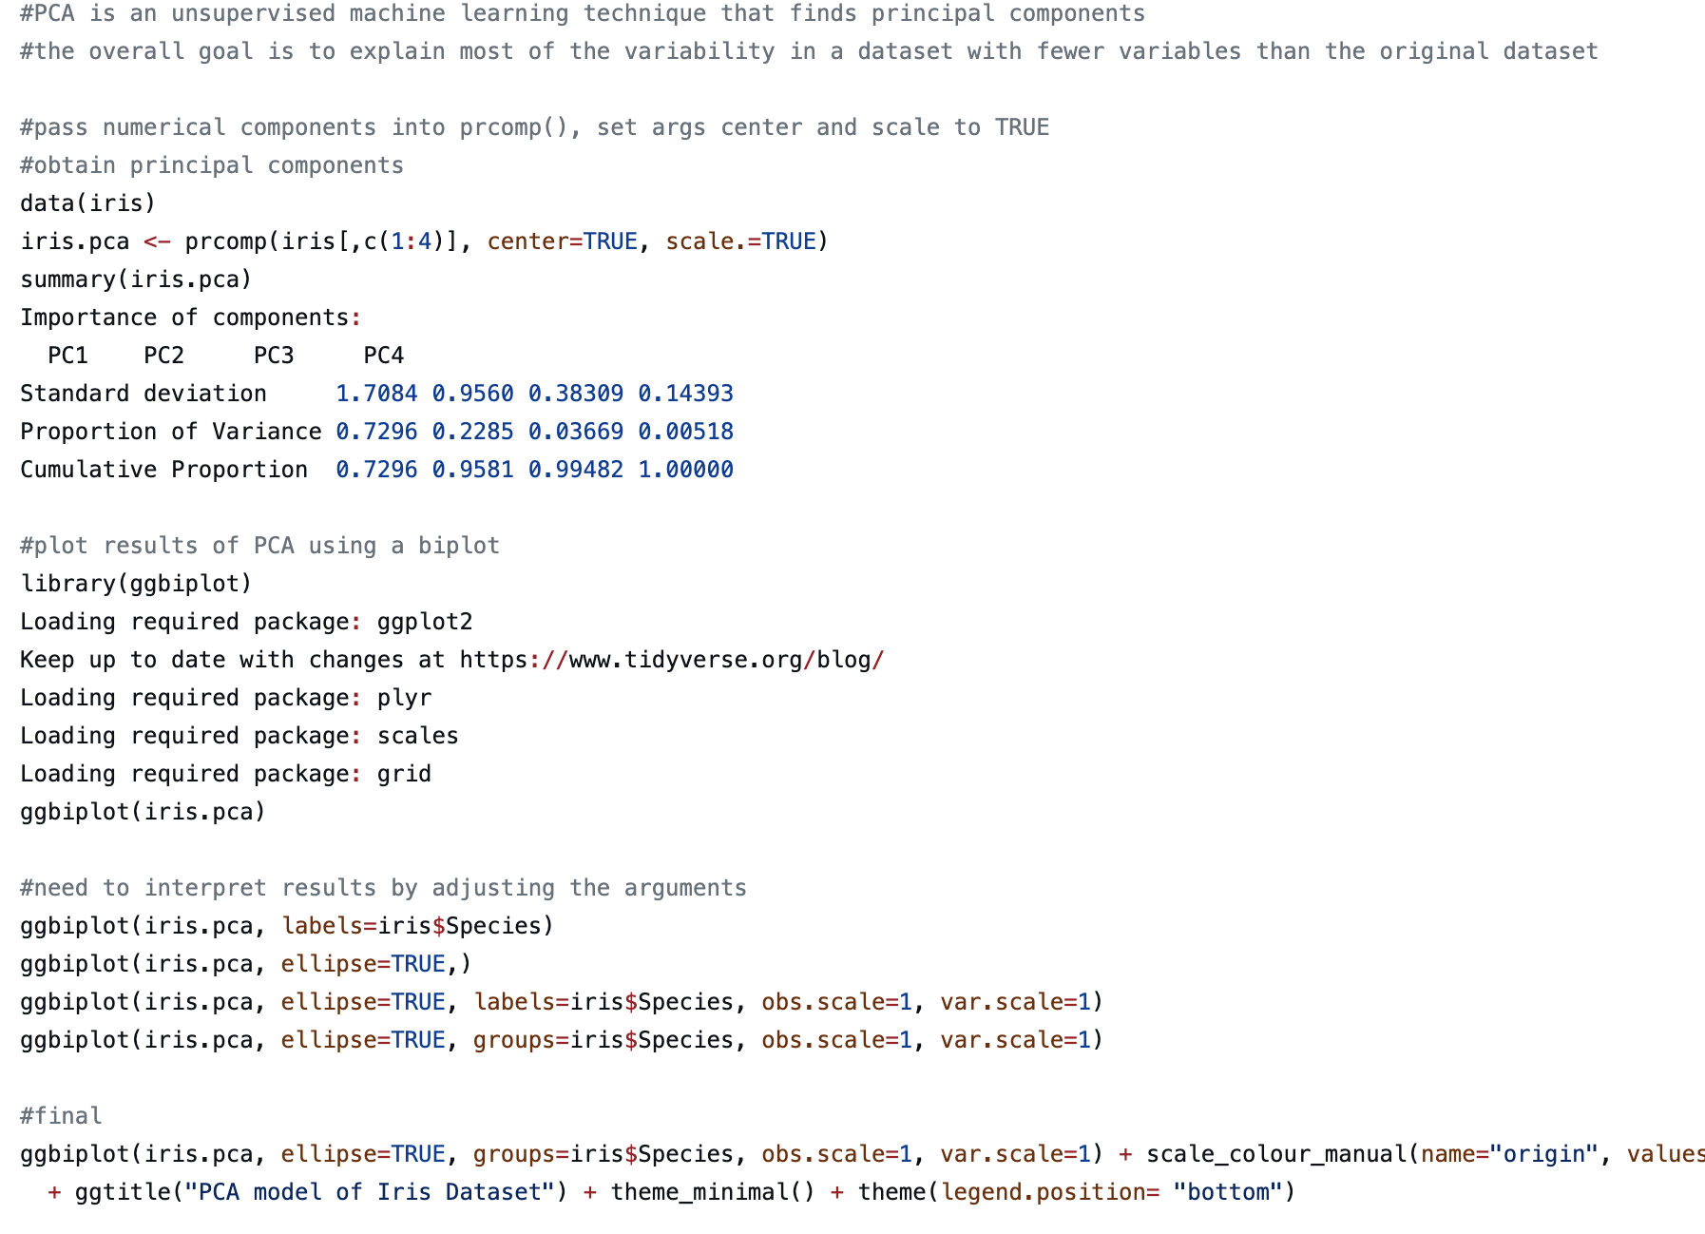
PCA- principal component analysis
Dimension reduction using linear algebra
Fast runtime
Outdated -> from the 30s

Slide 4
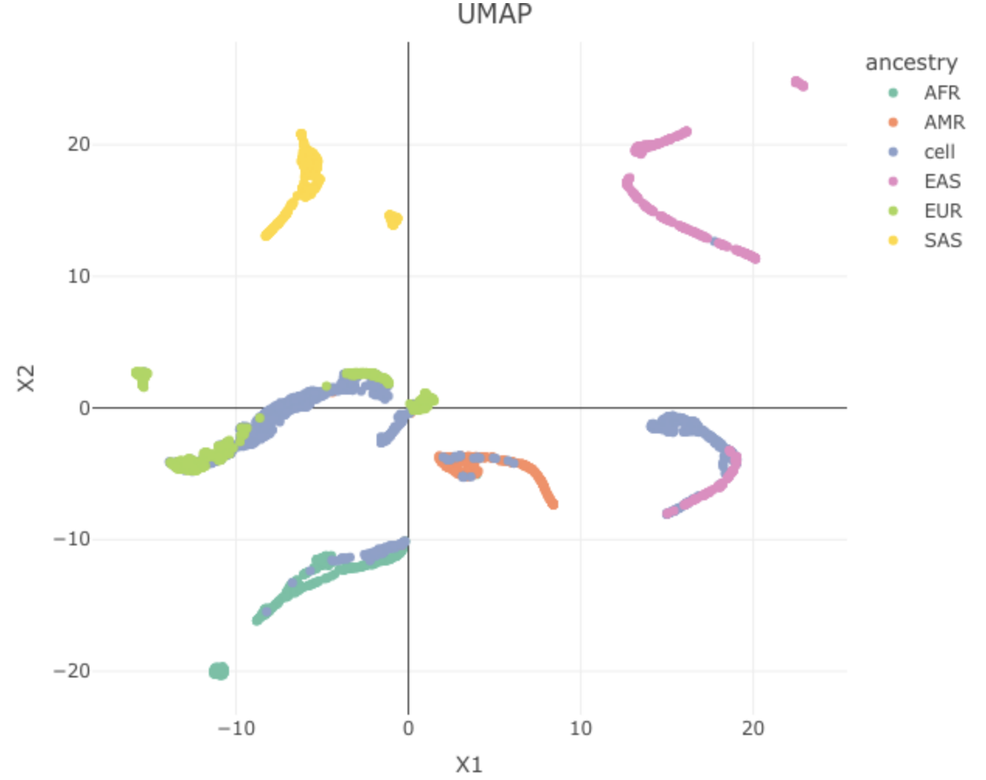
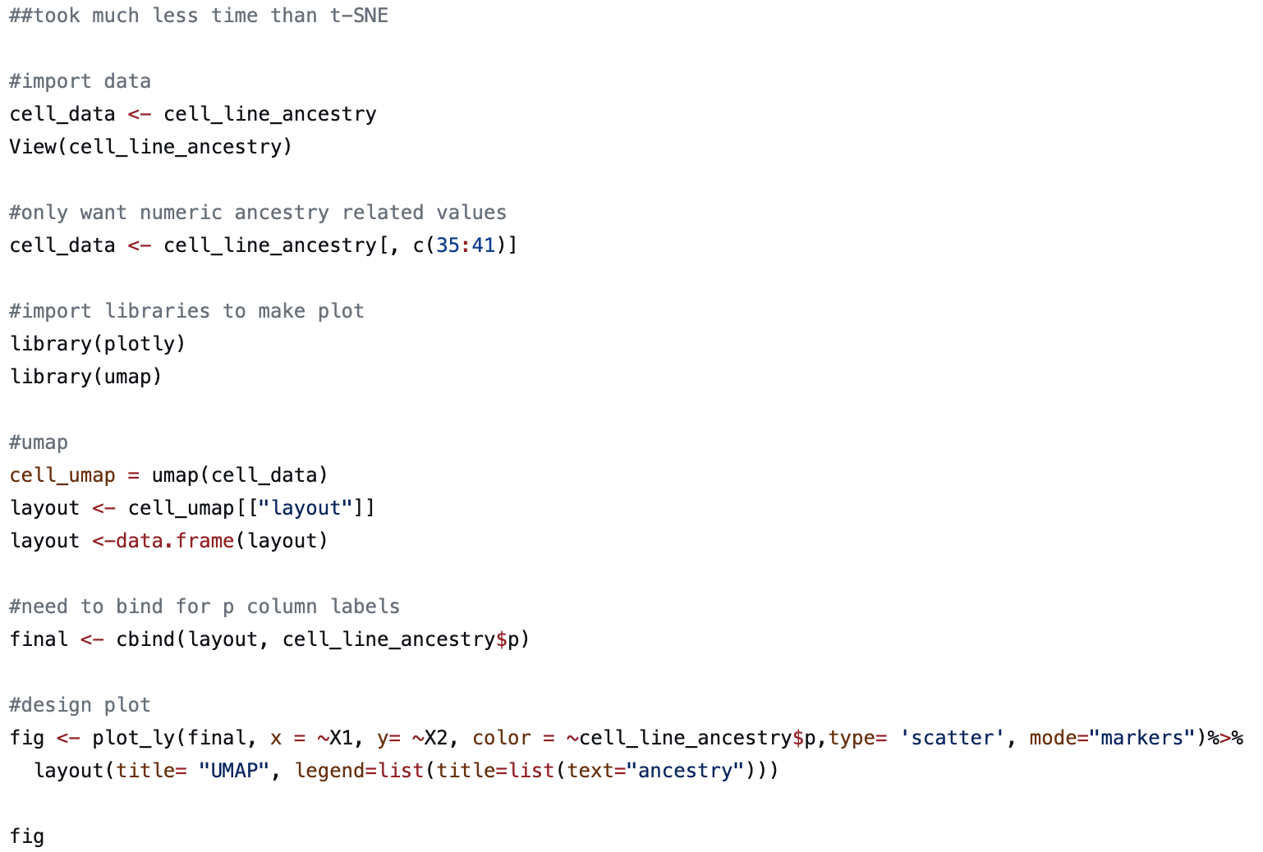
UMAP
Faster version of t-sne
Doesn’t have too much documentation

Slide 5
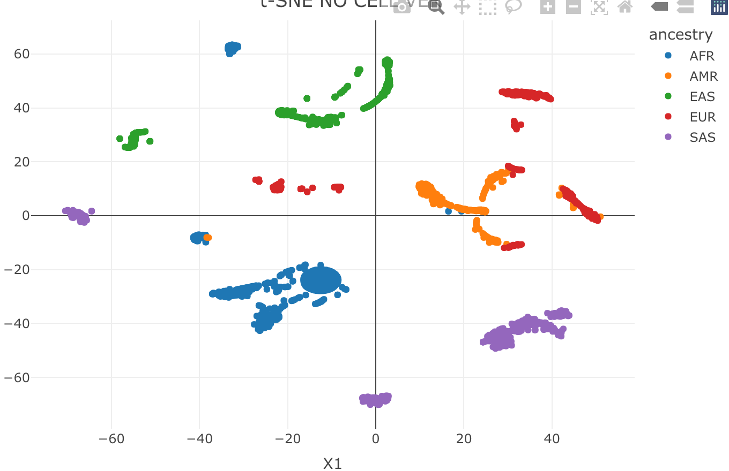
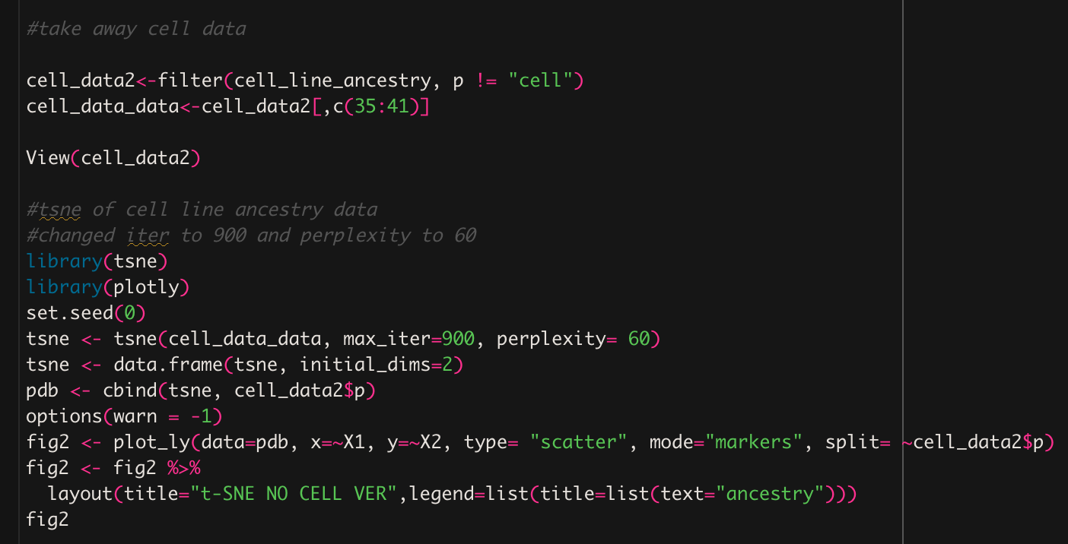
t-SNE
Long runtime
Overall the best parameter-wise
Took out “cell”

Slide 6
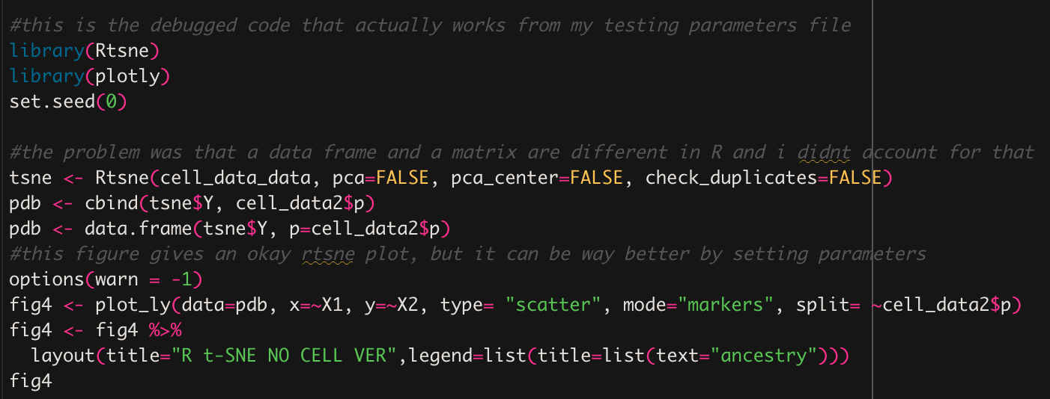
Rtsne package
Much faster as it parses through a C interpreter rather than rstudio

Slide 7
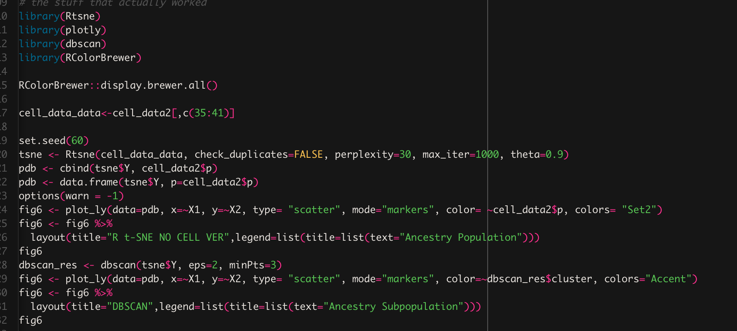


Setting parameters to make graph look better
Testing different things

Slide 8
DBSCAN
Based off KNN alg
Distance
continuous

Slide 9
How accurate is the DBSCAN vs the data we know
Goal is to have a numerical measurement for how accurate the clusters are
Is each subpopulation represented

Slide 10
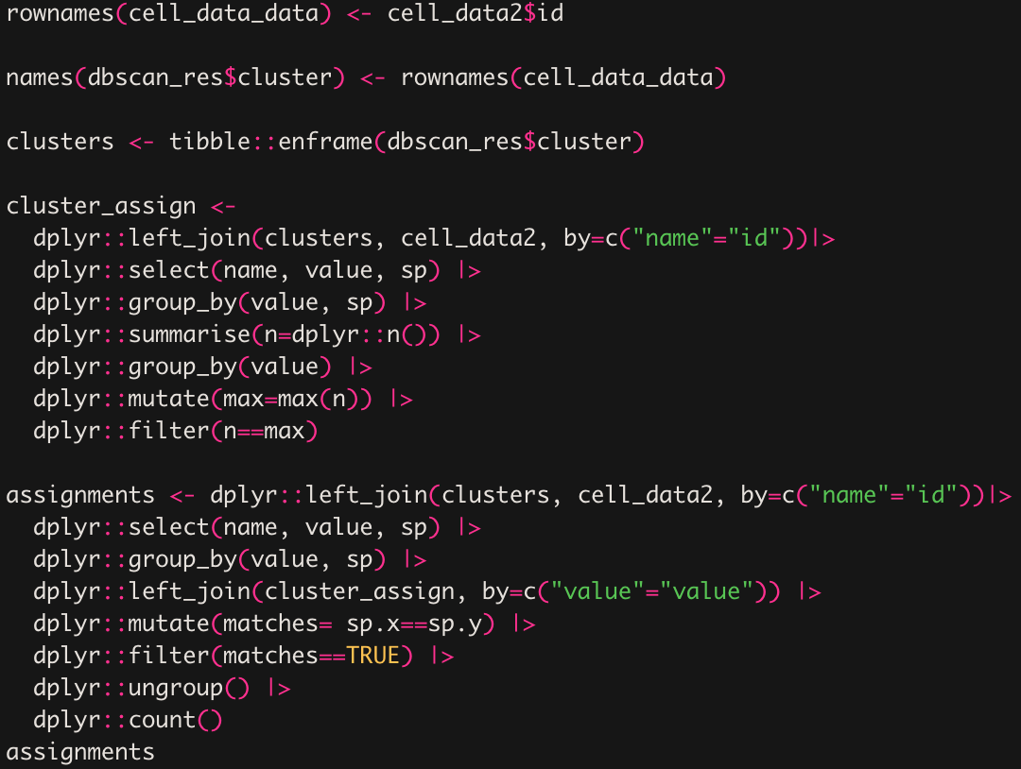
SQL

Slide 11
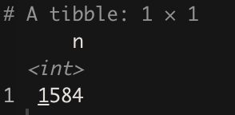
Result after running

Slide 12
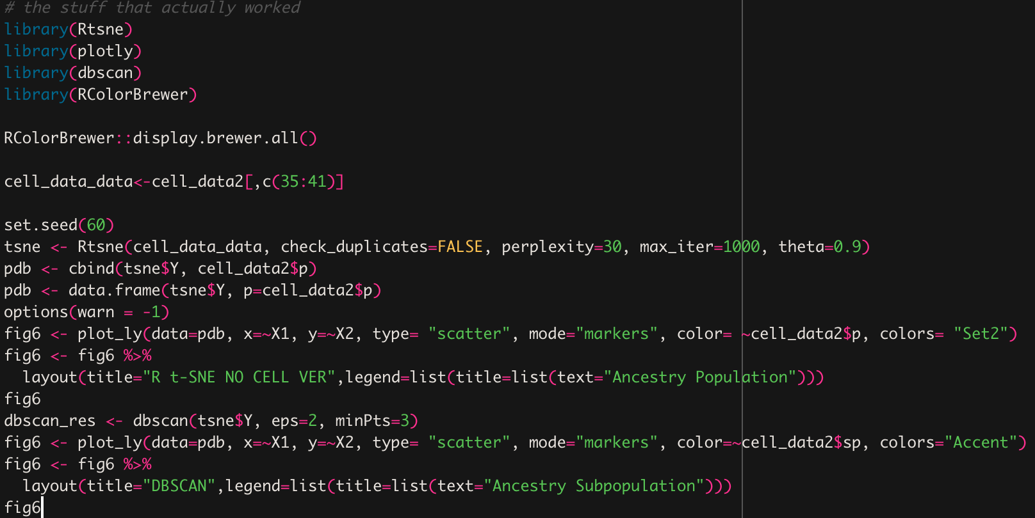
“Final” parameters

Slide 13
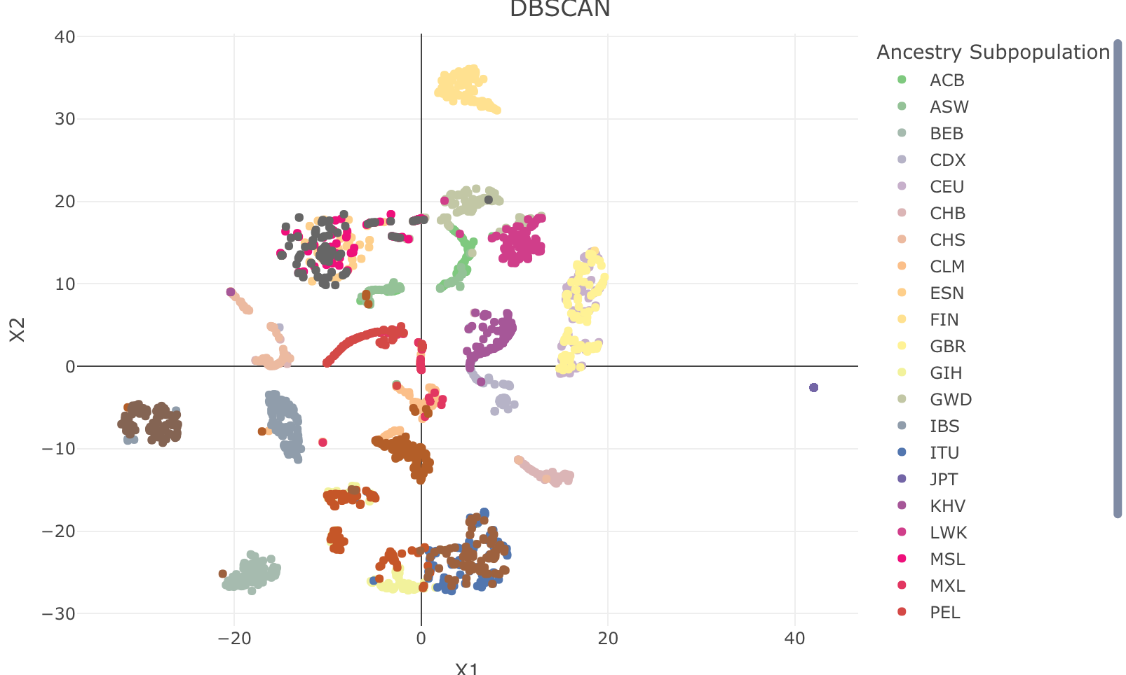
Visual
So far

Slide 14
Next steps
Coming up with a more visually readable graph
Being able to replicate with a data set that has more variables

Slide 15
Thank you.

